Slide 1
A Configurable SRAM for Low-Voltage Operation in 32nm High-κ Metal-Gate CMOS
Manny Xu CKT
20180502

Slide 2
Agenda
Background
constant-negative-level write buffer
level programmable wordline driver

Slide 3
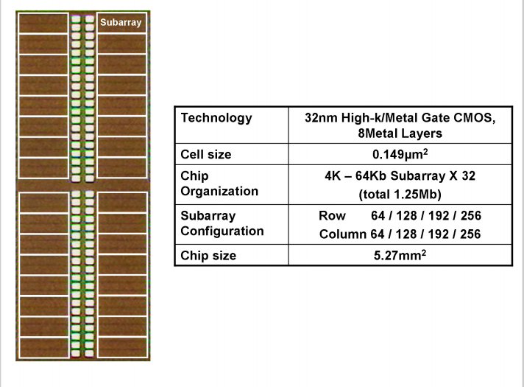
背景
a configurable SRAM for low-voltage operation
Notes:
Functionality and high yield at low supply voltages such as 0.7V has become more difficult to achieve with the degradation of write margin and the optimization between read disturb and write margin

Slide 4
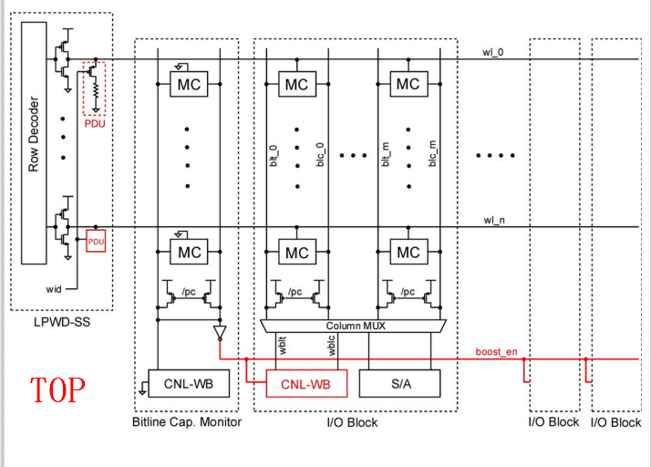
背景
BL negative biasing and WL level control
Notes:
BL capacitance monitor working as a replica of a BL generates a signal activating the bootstrap (boost_en). Every WL driver has a pull-down unit (PDU) to lower the WL voltage for optimizing the tradeoff between disturb and write margin.

Slide 5
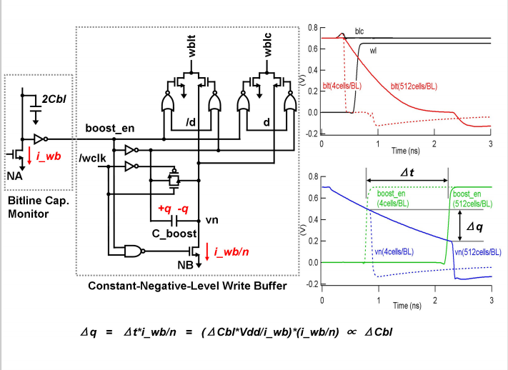
constant-negative-level
Notes:
针对写buffer

Slide 6
constant-negative-level
automatic BL-level adjustment for configuration range of 4 to 512 cells/BL
automatically control the amount of charge stored in the bootstrap capacitor C_boost depending on the number of rows
Notes:
针对写buffer

Slide 7
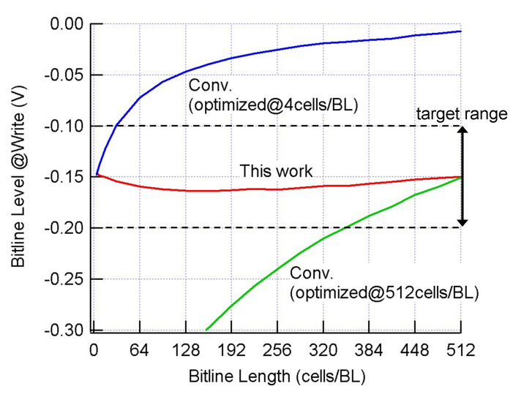
constant-negative-level

Slide 8
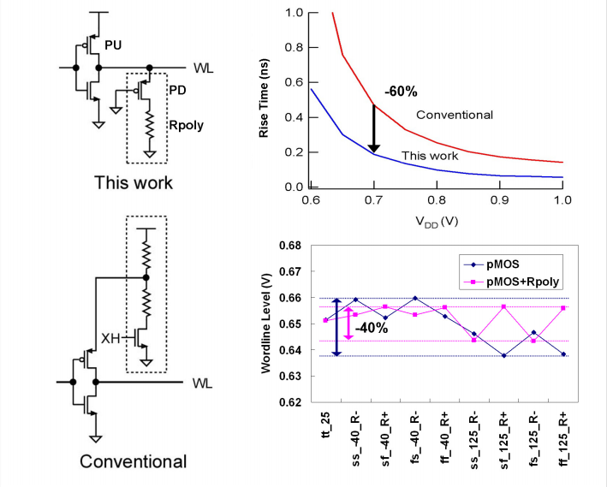
level programmable wl driver

Slide 9
level programmable wl driver
optimizes the tradeoff between disturb and write margin
allowing a 60% shorter WL rise time

Slide 10
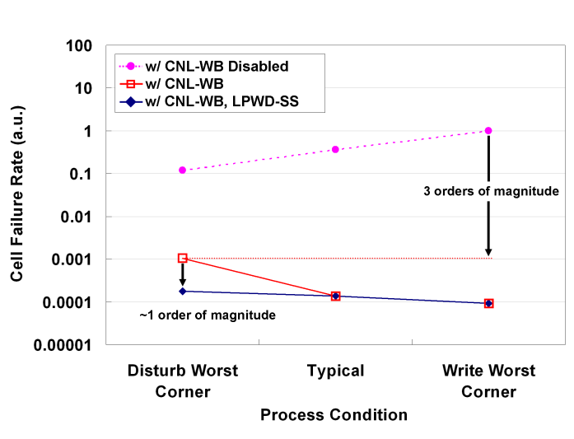
summary
Measurement results demonstrate a cell-failure rate improvement of two orders of magnitude for an array-configuration range of 64 to 256 rows by 64 to 256 columns

Slide 11
Thank you

